Slide 1
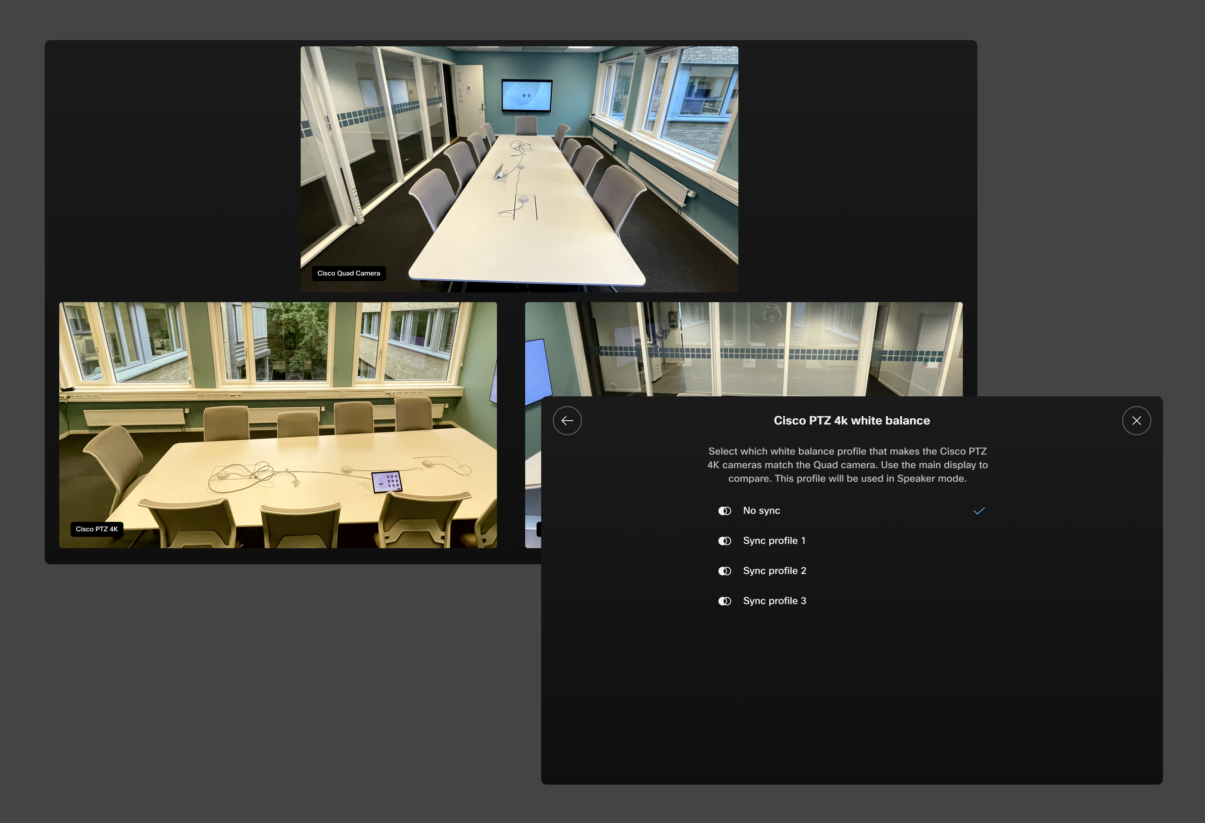
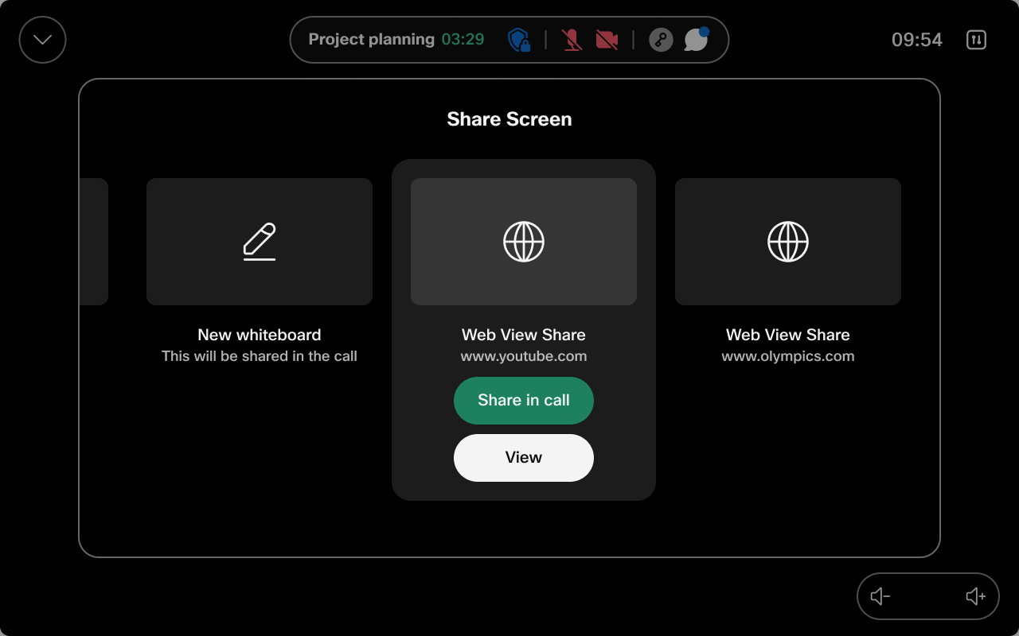
Share Web Apps as content
White balance calibration for multicam setups.

Slide 2
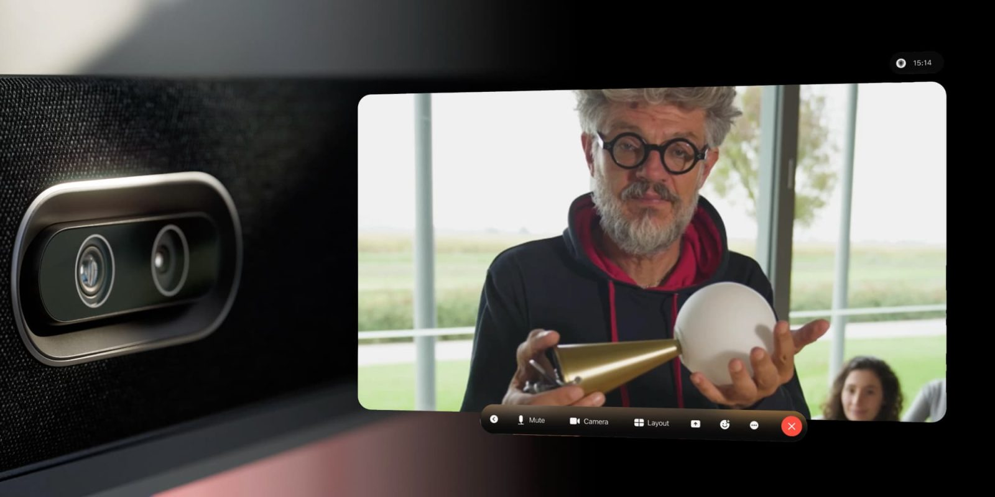
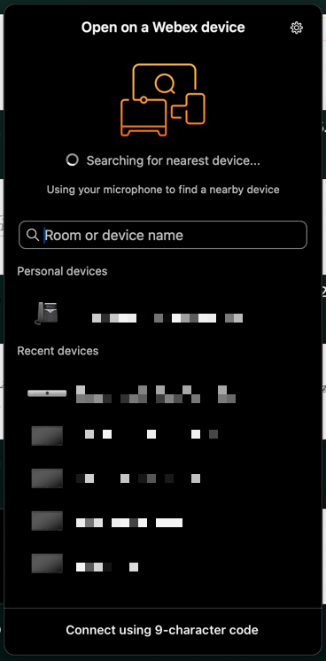
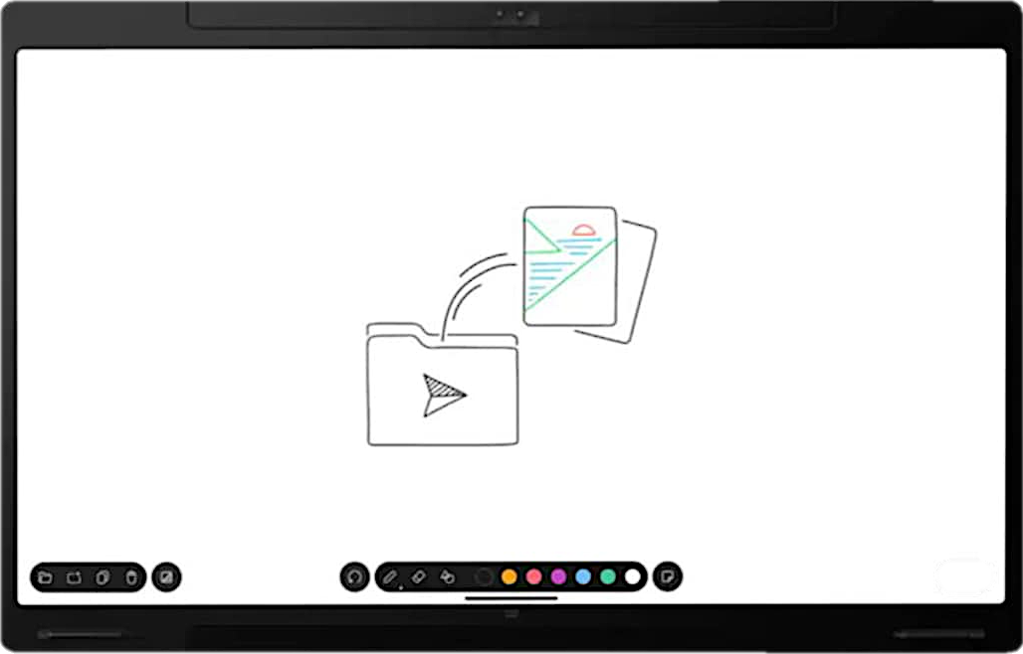
Open Webex Whiteboards on Devices via the Webex App
Spatial Meetings for Room Bar Pro

Slide 3
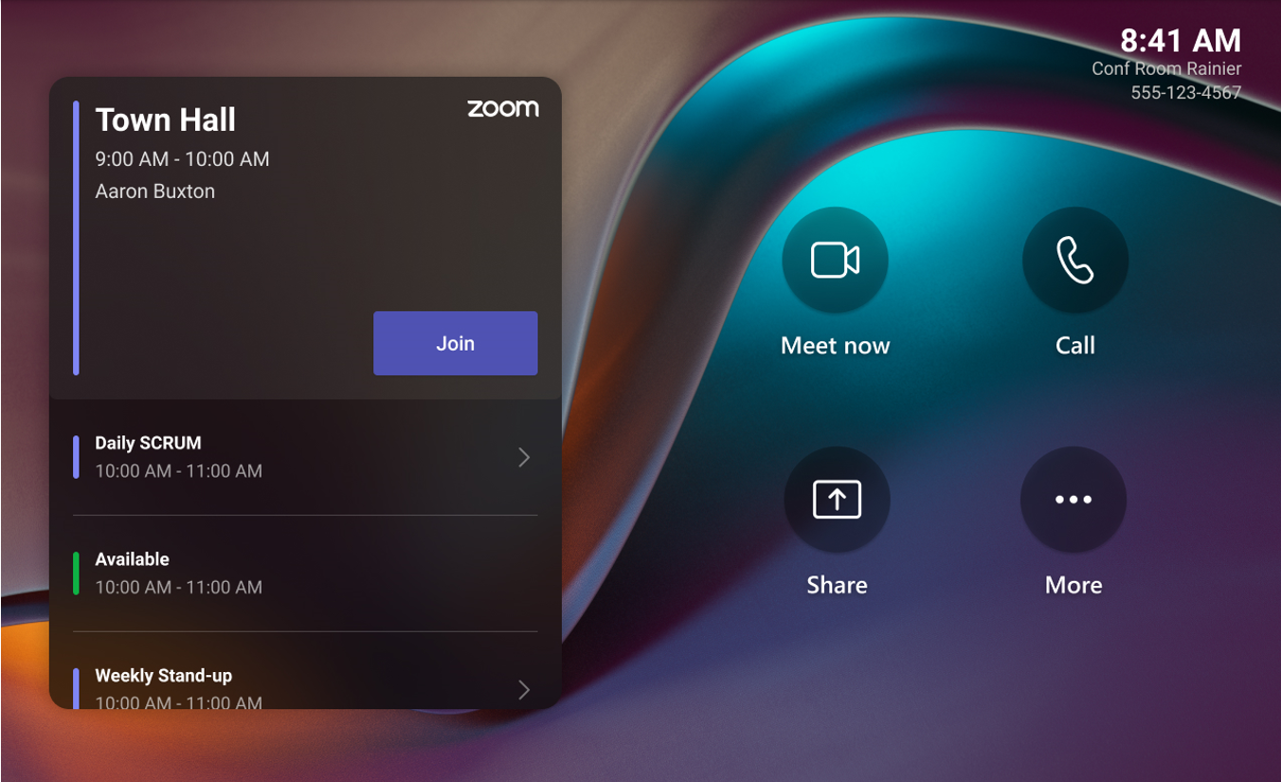
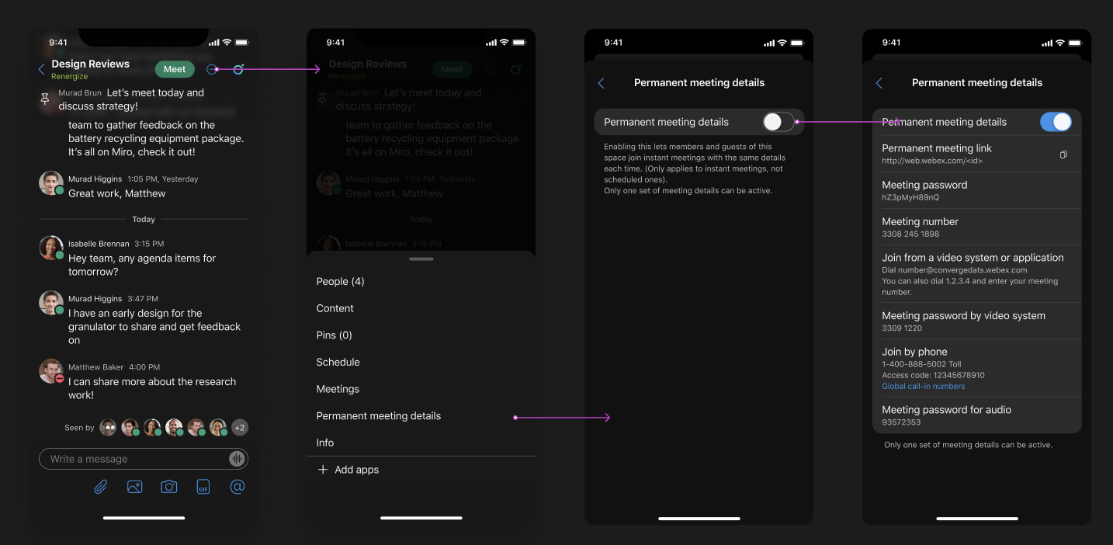
OBTP Support for Zoom CRC for Cisco MTR
Permanent Links for Ad-hoc Space Meetings

Slide 4
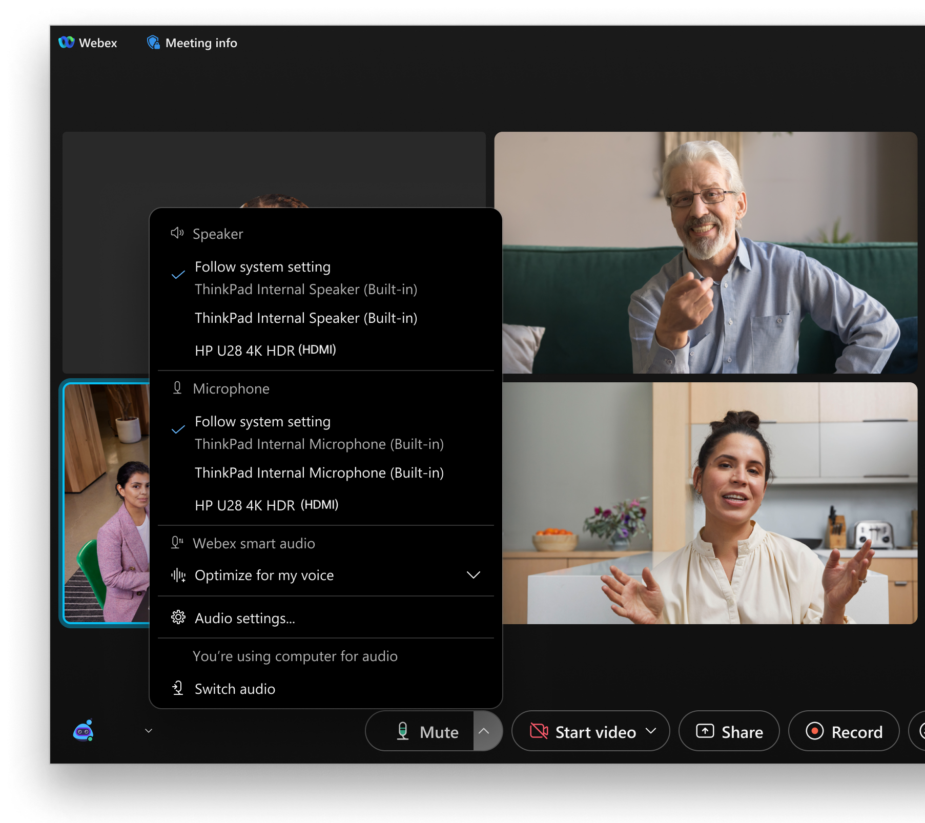
Faster meeting join experience - combine sign-in/join as guest and display name steps
Choose the correct audio device for meetings

Slide 5
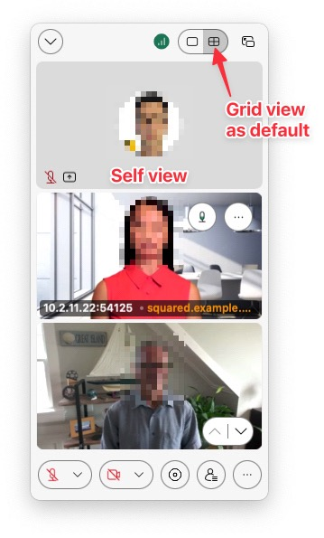
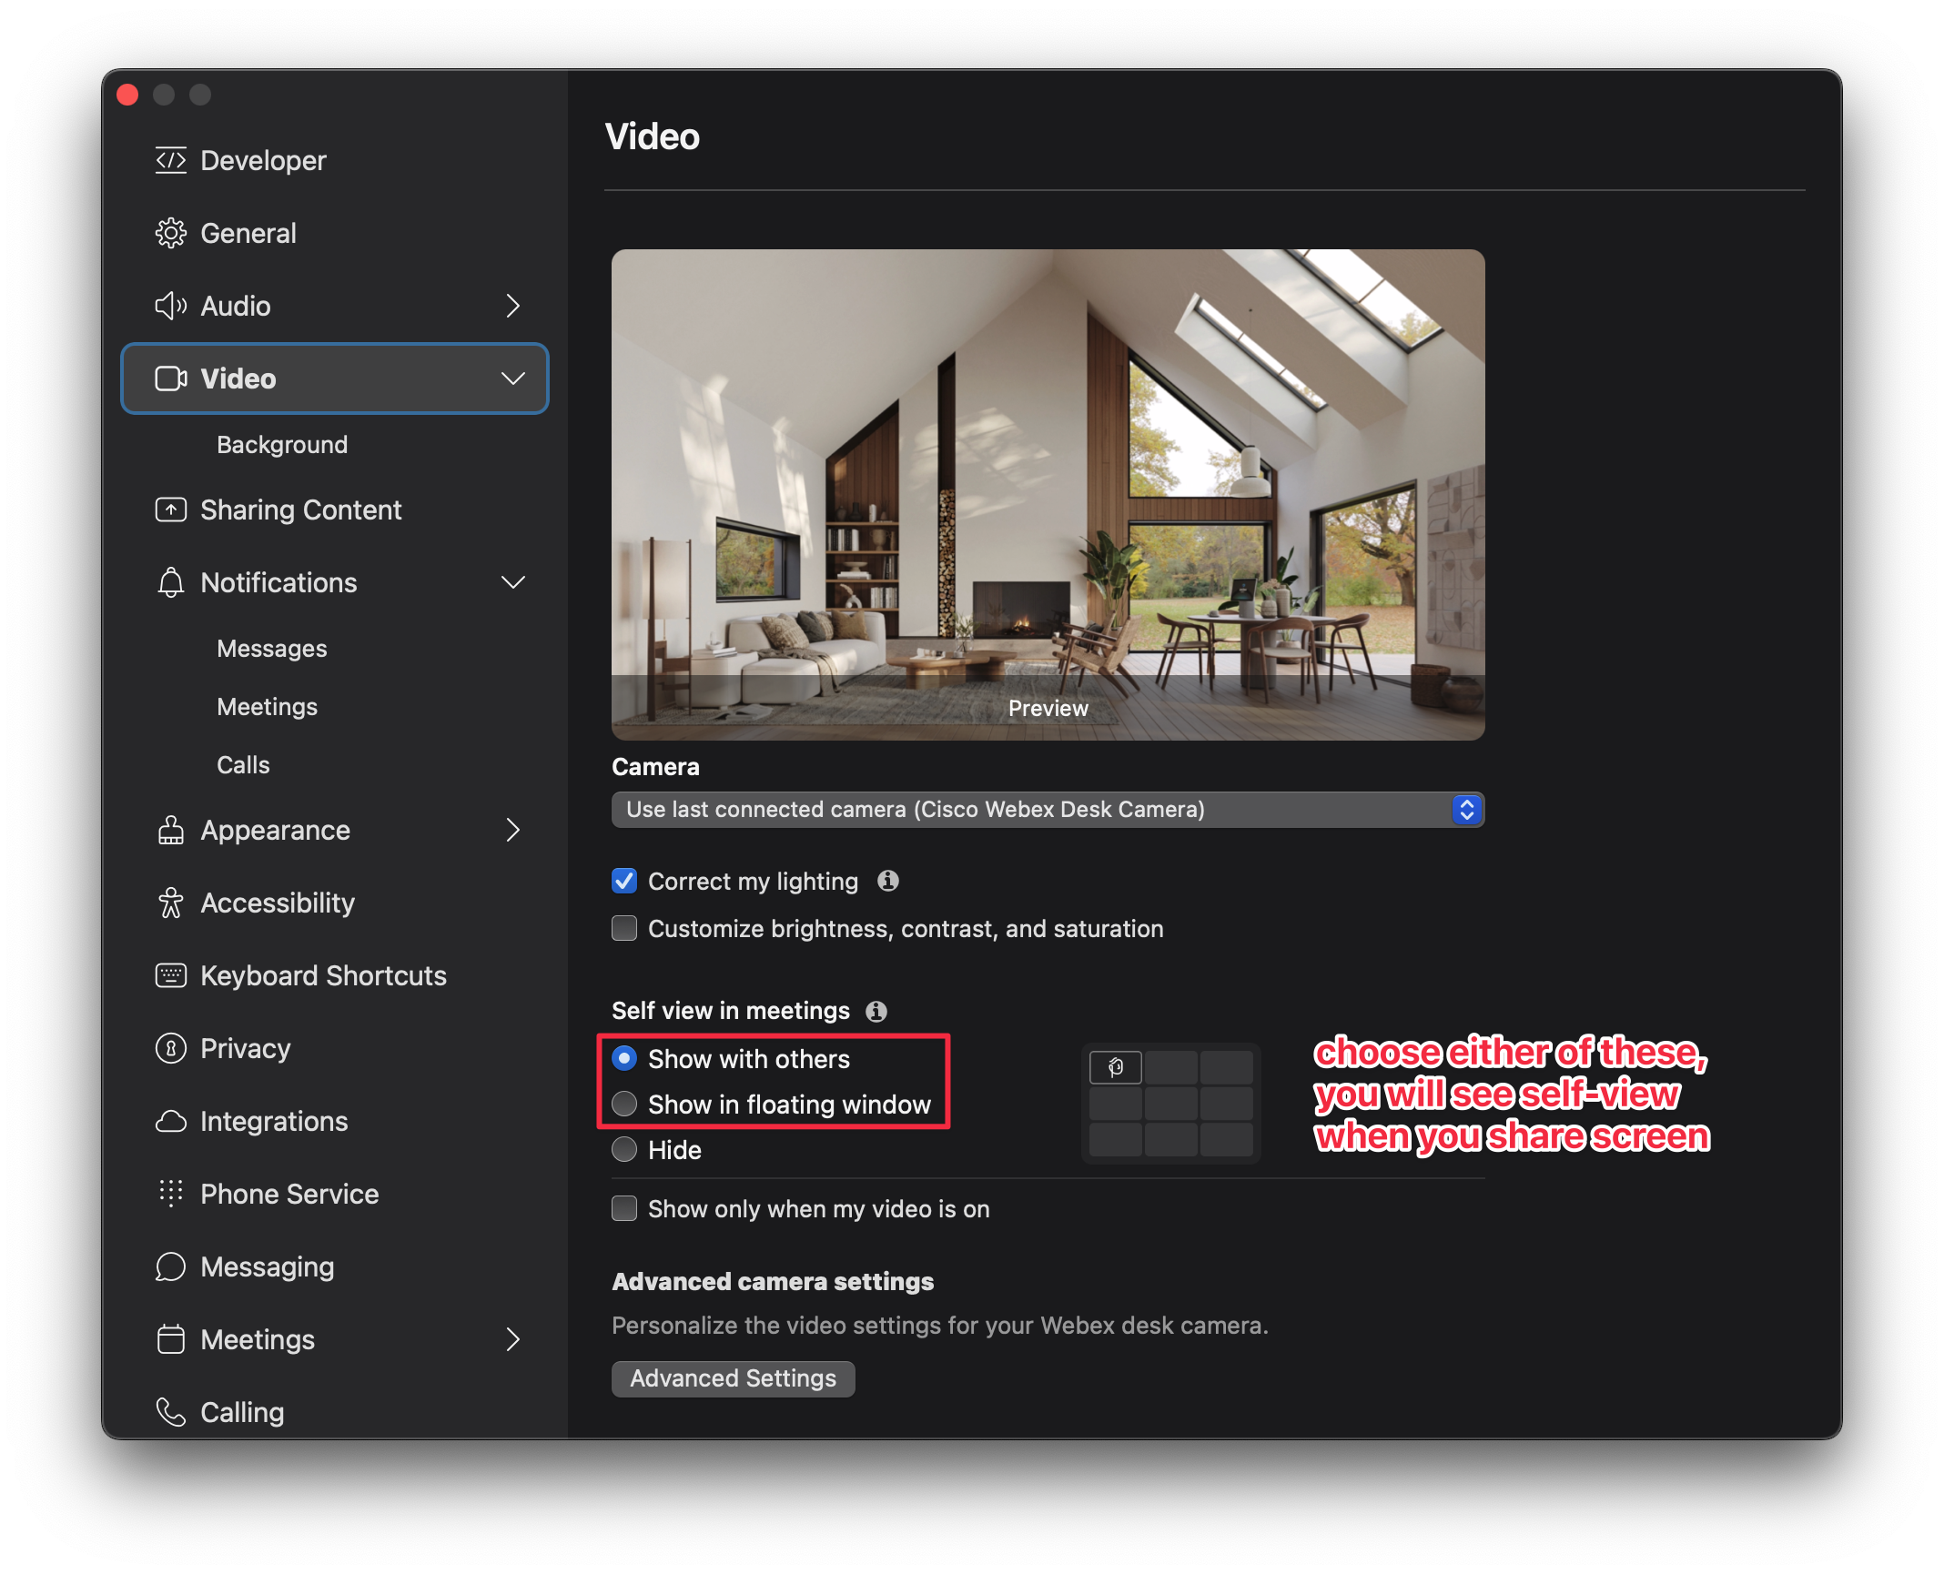
Grid view default for presenter in floating video window, along with self-view

Slide 6
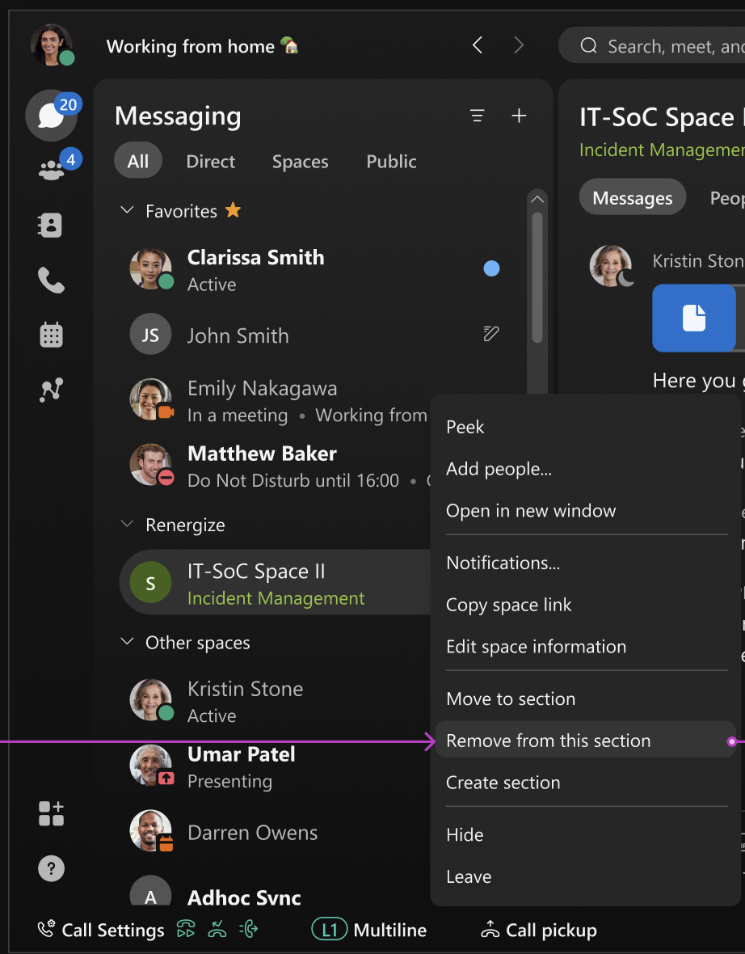
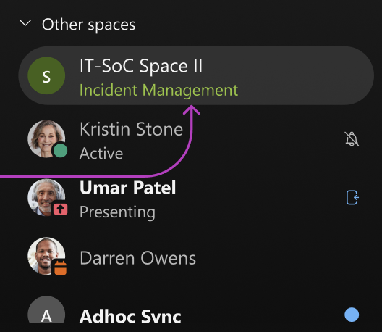
You can easily remove a space from a section
Right click on space

Slide 7
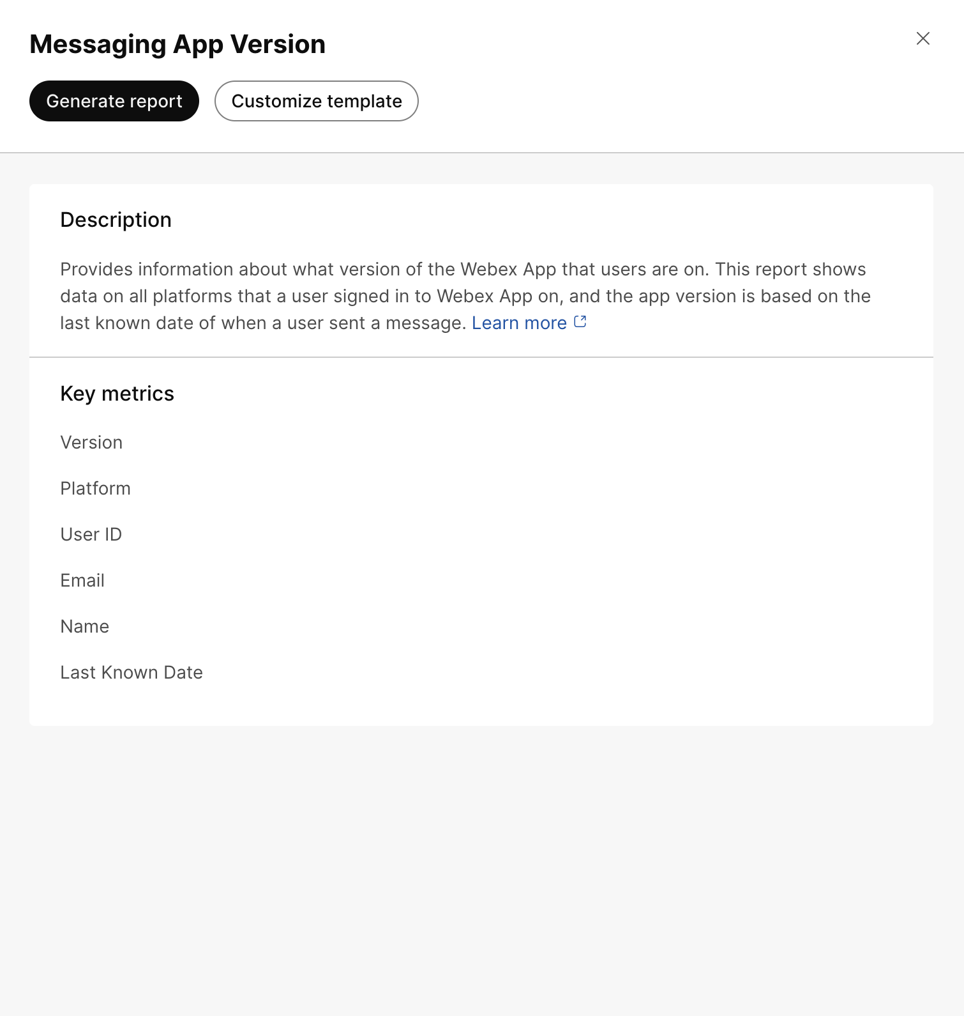
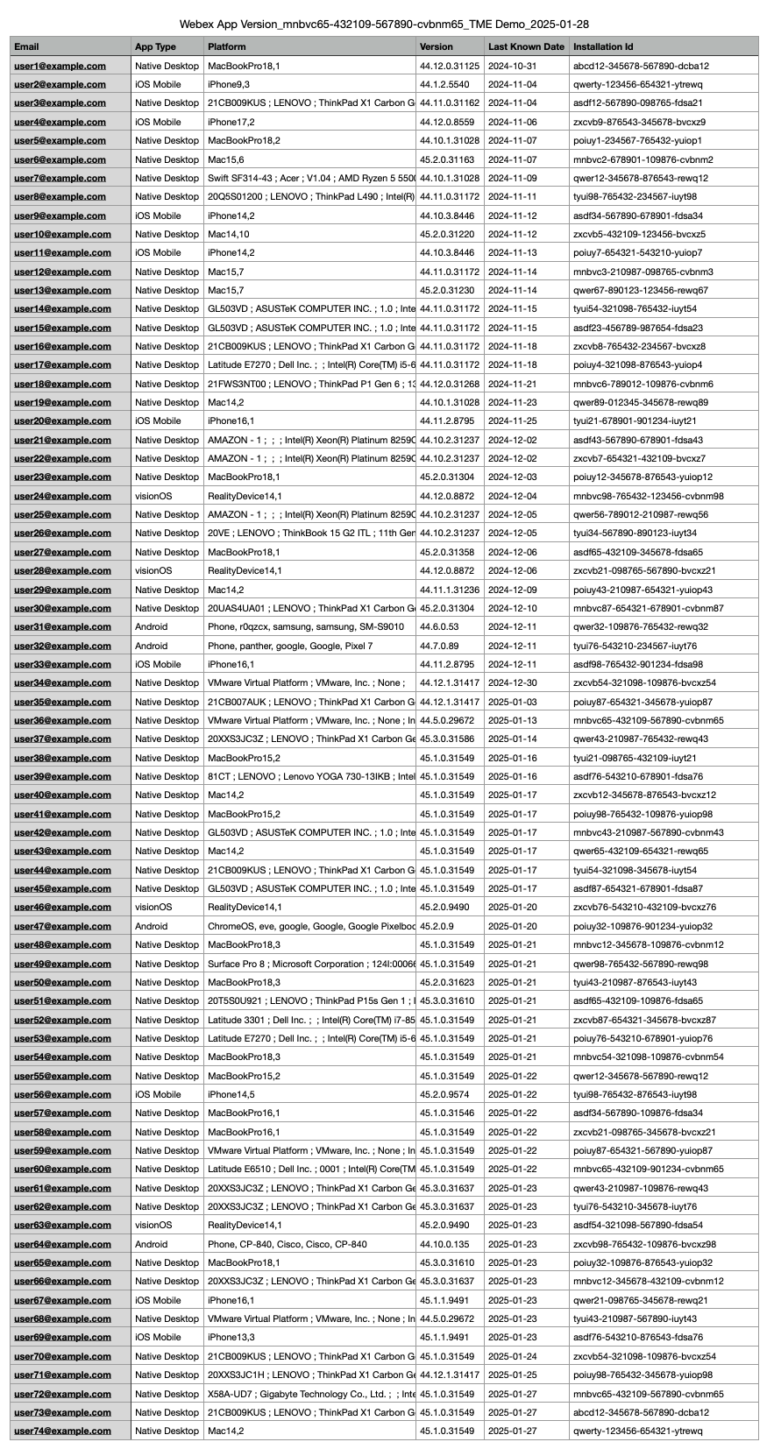
Troubleshooting data for users and devices joining external meetings
Webex App version report in Control Hub

Slide 8
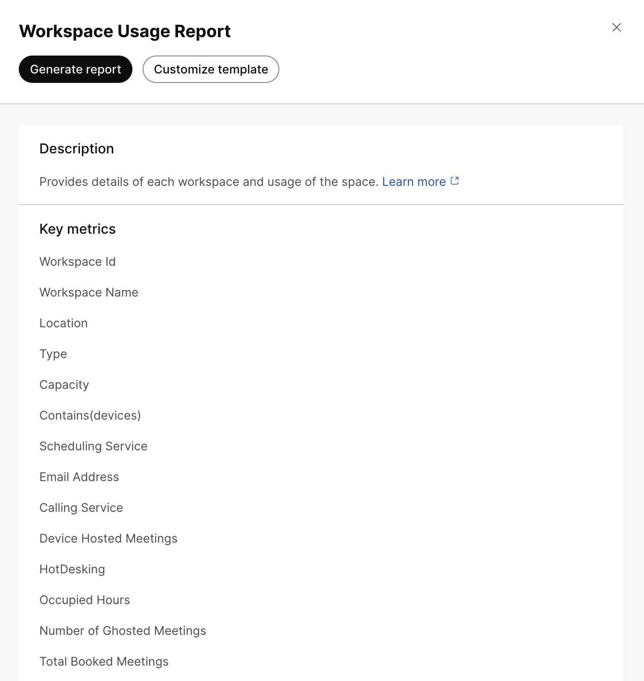
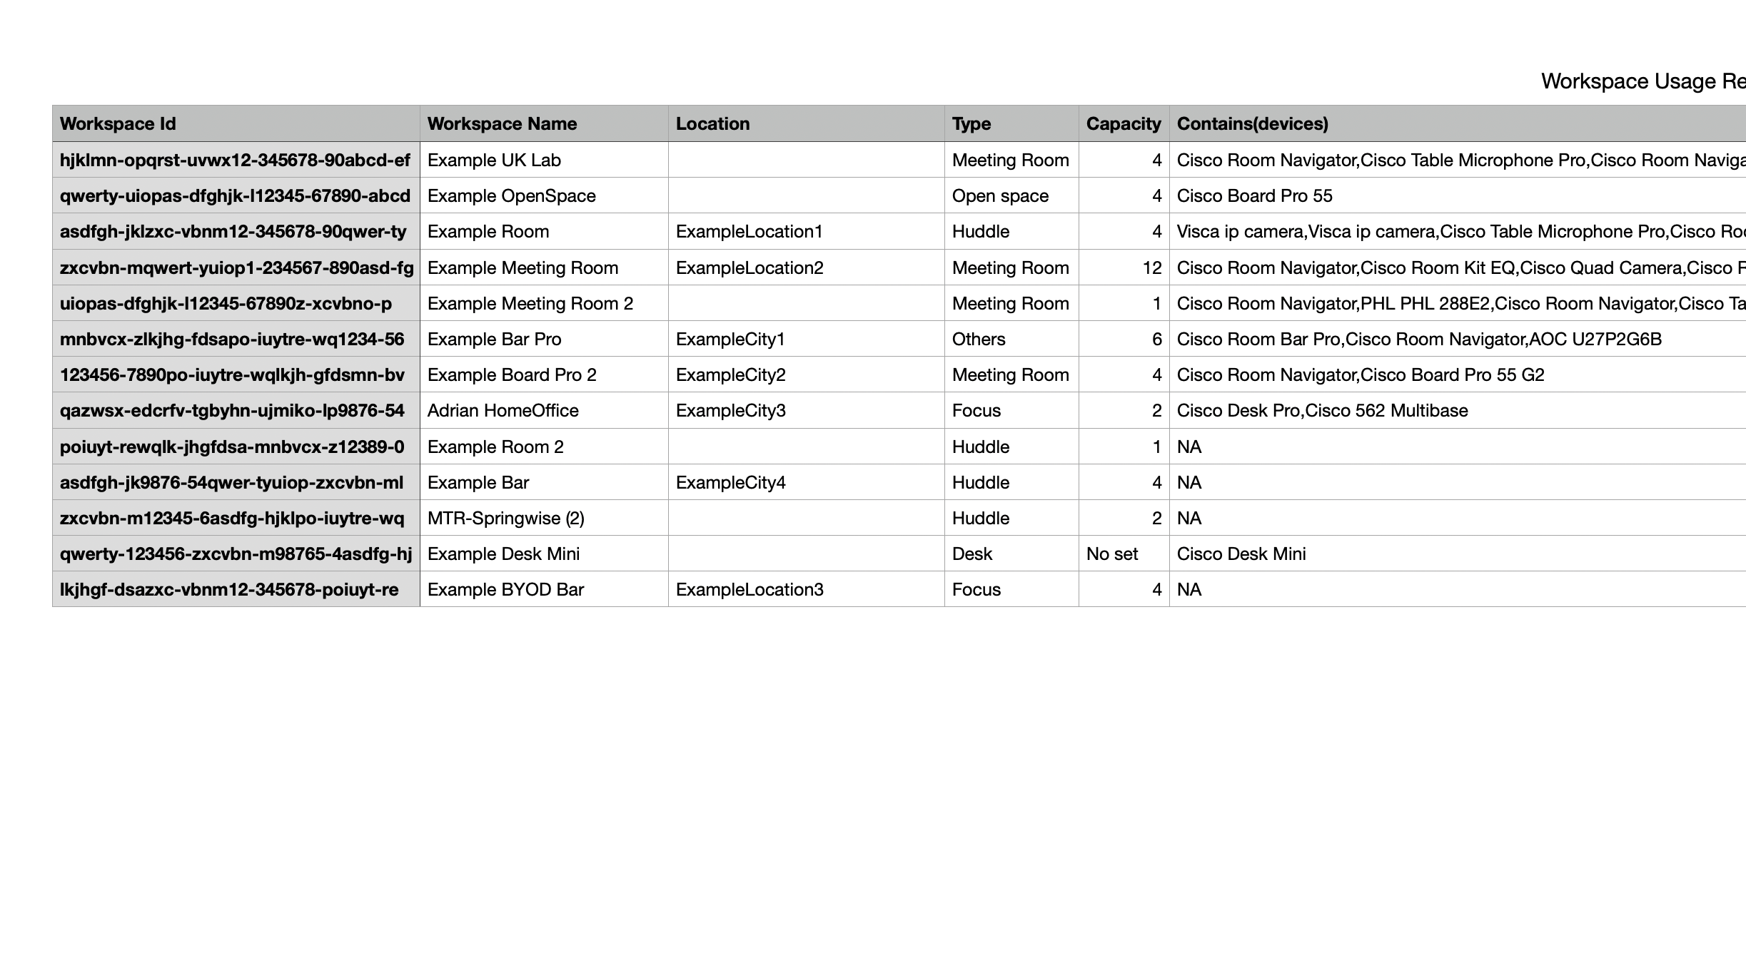
Workspace room usage report
Webhooks set up and usability enhancements

Slide 9
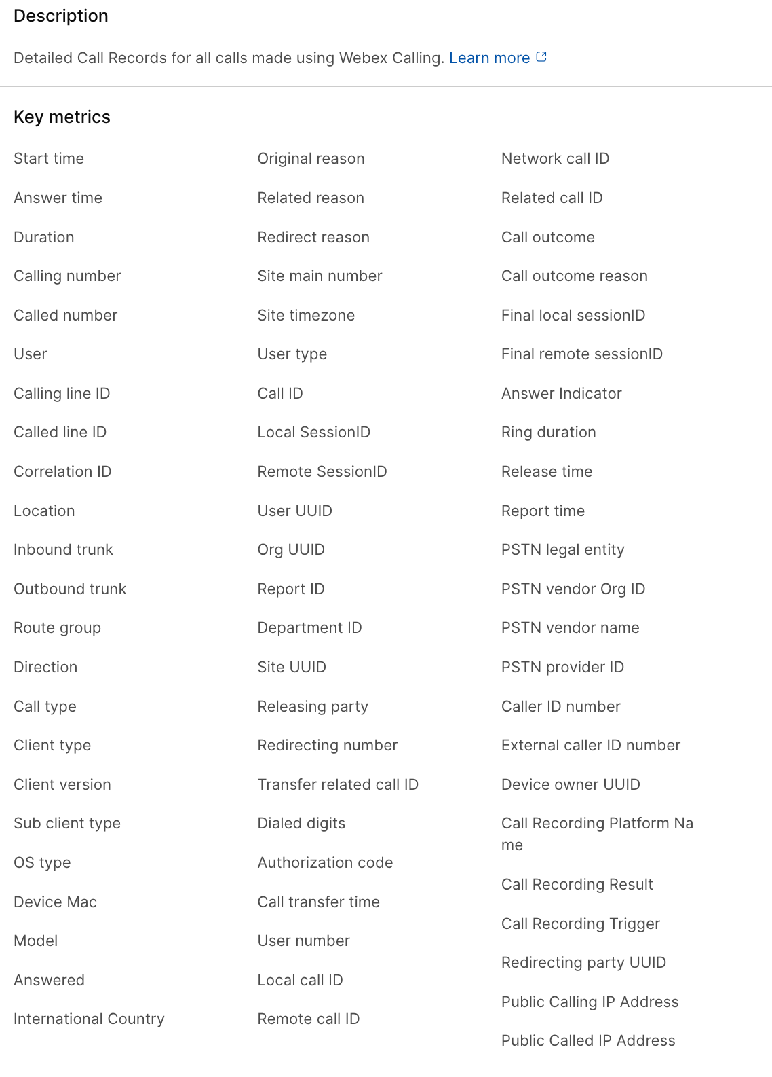
Allow Admins to view sync source in Control Hub UI
New CDR Fields

Slide 10
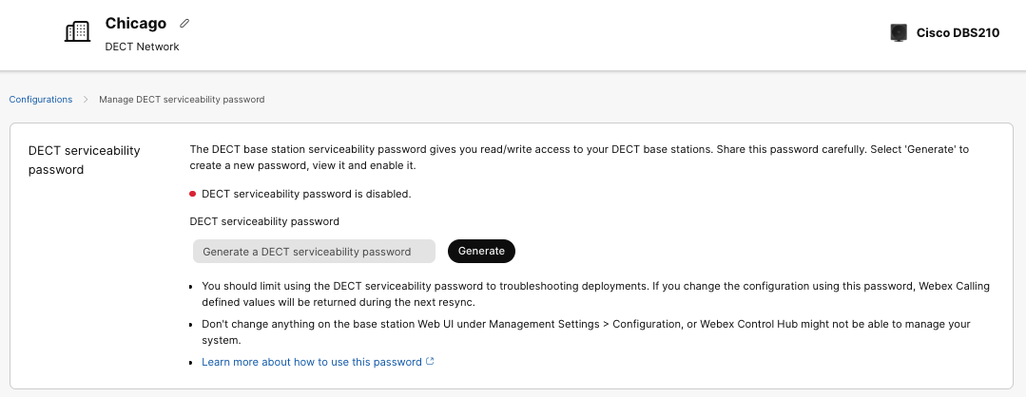
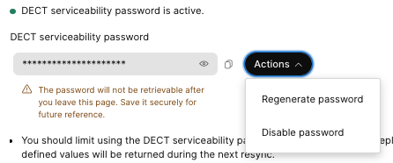
DECT - Admin access to DECT base station password

Slide 11
Get to know the Webex Beta Program

